Slide 1
Running a Successful Open Source Project
Rob Reynolds
Puppet, Inc

Slide 2


Slide 3
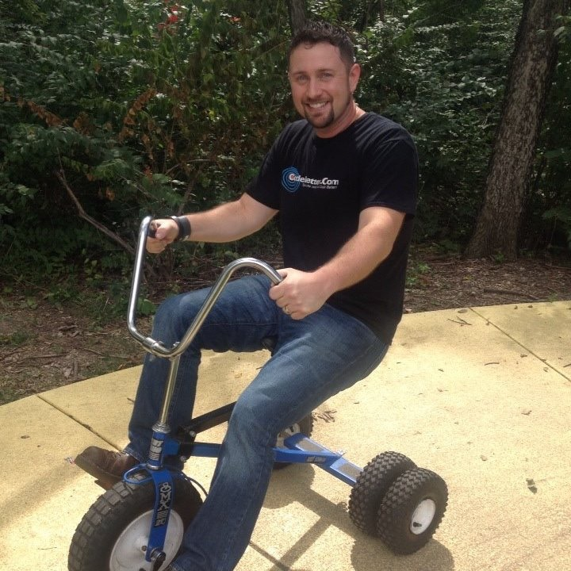



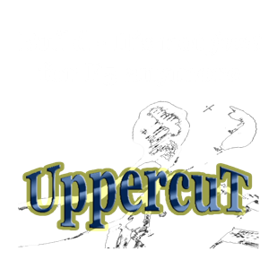
Rob Reynolds
Senior Software Engineer on the Windows Team at Puppet
Creator of Chocolatey
Enjoys long walks on the beach and designing solutions that make hard things easy
Co-wrote infrastructure framework known as the Chuck Norris Framework
Over 10 years experience in infrastructure automation
Obsesses over user experience

Slide 4
Open Source Software Experience
Work on Puppet
Work on Chocolatey
Work on RoundhousE and other Chuck Norris Framework tools
Contributed to numerous OSS projects

Slide 5
Topics
Success?
Passion
Go It Alone
Decision Structure
Legal
Versioning / Release Structure
Time Management
Documentation
Contributors / Committers
Learn to Take Critical Feedback
Collaboration
The Long Haul
Finding New Owners
Final Thoughts

Slide 6
So How Do You Run A Successful OSS Project?

Slide 7
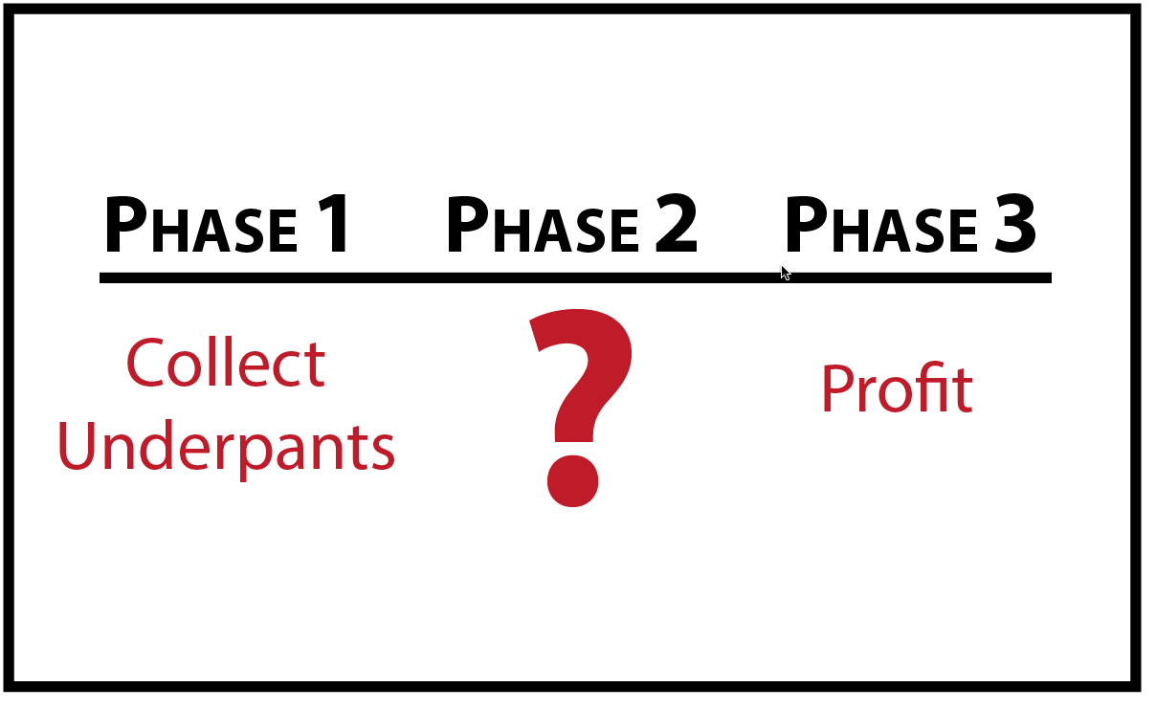

Slide 8
Define Success
What does it mean for you when working in open source?

Slide 9
Defining Success for Rob
Solving a Problem
Building a Community
User Experience

Slide 10
Find a Passion
You must be passionate about your project
No one else will be for you
You must be a user of your project

Slide 11
Go It Alone
“I know, I’ll open source this and get help” <- The wrong idea

Slide 12
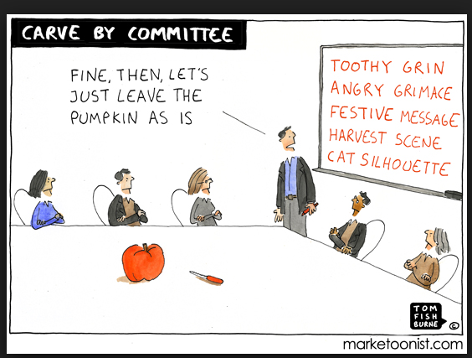
Decision Structure
Benevolent Dictator?
Small Group?
By Vote?
Design By Committee?

Slide 13
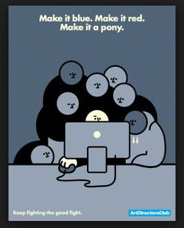

Slide 14
Decision Structure
Recommendation - Benevolent Dictator
“Open Source is not a democracy.”
Standards Committees

Slide 15
Legal
Pick a Friendly Open Source License - https://opensource.org/licenses
Recommend Apache 2 or MIT
GPL if you want CopyLeft
Contributor License Agreement
http://harmonyagreements.org/

Slide 16
Versioning / Release Structure
Semantic Versioning - https://semver.org
Where will your releases be?
Will you offer multiple versions at a time?
Do not force someone to upgrade
ChangeLog - What breaks, how to mitigate

Slide 17
Time Management
Set some time aside
“If you are not good at time management now, learn to be.”
Email Filters
Still many messages per day
Find Community Members To Help
Documentation

Slide 18
Documentation
Docs are usually most hated thing to do
Very important
“An Ounce of Documentation Saves A Hundred Requests”

Slide 19
Marketing
You must tell folks about what you are doing
Blogging, showing it to prominent folks for them to blog
Put it on package managers for discovery
Build info/demo into talks at conferences
Develop an elevator pitch
Does it make sense to non-technical folks?

Slide 20
Contributors / Committers
Set expectations
Document processes
Document Code Design
Provides direction for folks

Slide 21
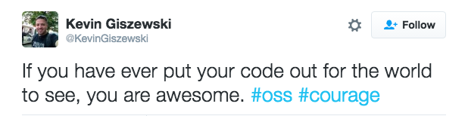
Learn to Take Critical Feedback
Project is Your Baby
“Not everyone will think your baby is beautiful.”
Most feedback is helpful
Some negative feedback is helpful once you get to issue
Some folks are just trolls
Know the difference between abuse and feedback

Slide 22
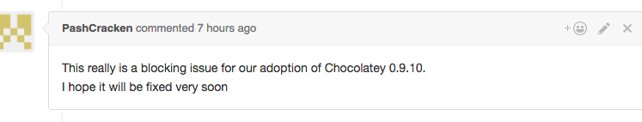
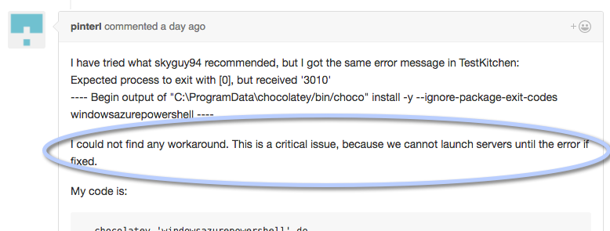
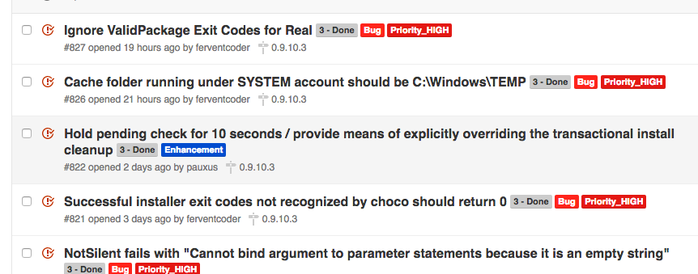
You Are Going To Break Stuff

Slide 23
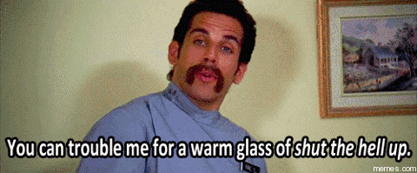
How Not To Collaborate

Slide 24
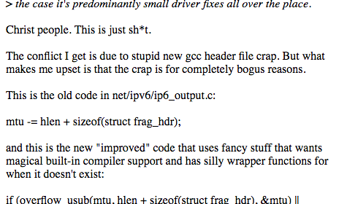
How Not To Collaborate
http://lkml.iu.edu/hypermail/linux/kernel/1510.3/02866.html

Slide 25
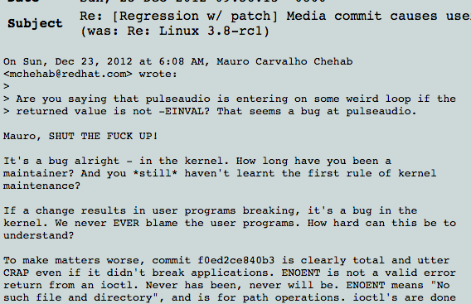
How Not To Collaborate
https://lkml.org/lkml/2012/12/23/75

Slide 26
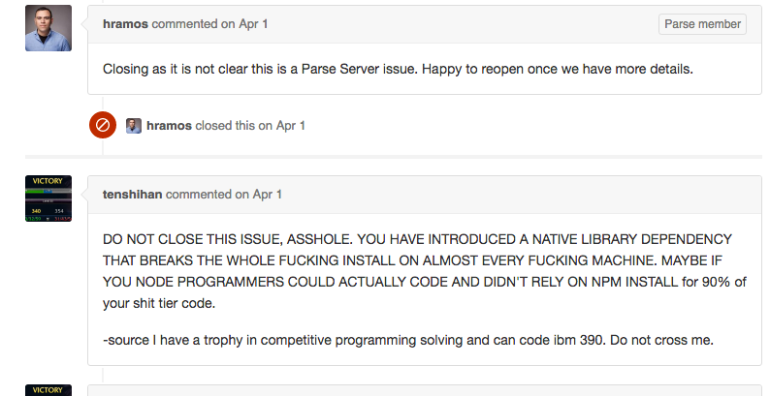
How Not To Collaborate
https://github.com/ParsePlatform/parse-server/issues/1050

Slide 27


Slide 28
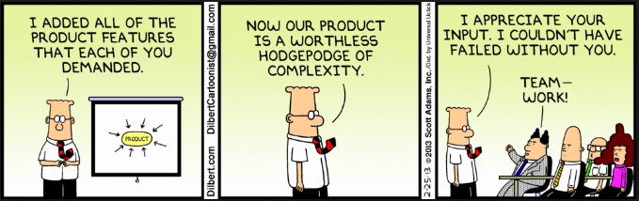
Collaboration - The Art of Being Nice
Be Humble
Be Friendly
Understand Context Prior to Judgment
Learn to Say No - https://blog.jessfraz.com/post/the-art-of-closing/

Slide 29
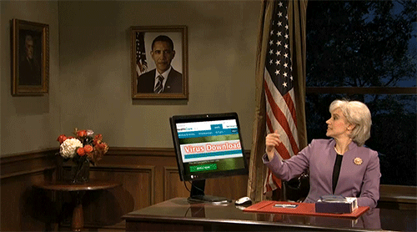
Collaboration - Fixing Issues

Slide 30
It’s Not All Sunshine and Roses
https://sethvargo.com/leaving-chef/
https://plus.google.com/+LennartPoetteringTheOneAndOnly/posts/J2TZrTvu7vd

Slide 31
Collaboration Mediums
Mailing List
Stack Overflow
Chat - Gitter, IRC and/or Slack

Slide 32
The Long Haul
Does this project have costs?
How do you plan to pay for those costs?
Your time and effort
Monetize? Sponsorship? Or Both?

Slide 33
Finding New Owners
Life Events
New Projects
Passions Shift
No Longer a User

Slide 34
Finding New Owners
No Owners
Letting the Project End
Backing Off - Is the community strong enough?

Slide 35
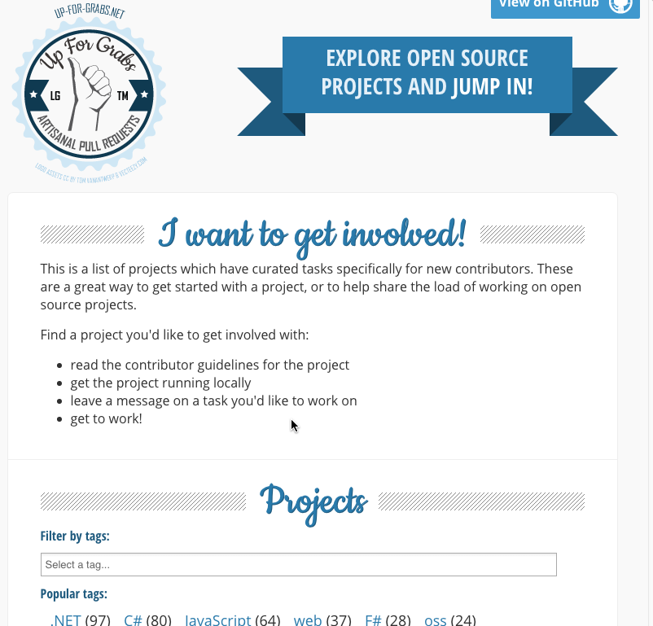
Getting Started - Contributing
When In Rome
Ask
Documentation
Smaller Things - Get Familiar
http://up-for-grabs.net/

Slide 36

Final Thoughts
Open Source is Rewarding
Notoriety
Opens doors for new careers
“It’s amazing to hear when folks find what you have created useful.”

